Slide 1
Analysis and identification of malicious mobile applications
CSE7101- Capstone Project
Review-2
Batch Number: COM_18
Under the Supervision of,
Mr. Sunil Kumar Sahoo
Assistant Professor
School of Computer Science and Engineering
Presidency University
Roll Number | Student Name
20221COM0165 | BHOOMIKA S HORAPETI
20221COM0144 | ROSHAN RAJU K K
20221COM0171 | AMOGH ARUN MALAGE
Name of the Program: COMPUTER ENGINEERING
Name of the HoD: Dr. PALLAVI R
Name of the Program Project Coordinator: Ms. BENITHA CHRISTINAL J
Name of the School Project Coordinators: Dr. SAMPATH A K , Dr. GEETHA A

Slide 2
Problem Statement Number: 68
Organization: Ministry of Power
Category (Hardware / Software / Both) : Software
Problem Description: ln today's world, using different mobile applications for specific tasks is very common. This leads to smart phone users accumulating too many applications over a period. Seldom do users delete unused applications. Any application performing malicious tasks can very easily go unnoticed. So, there is a need to develop a mobile app tool that can use open-source intelligence and threat feeds to detect various indicators of compromise in the smartphones. The tool can check network communication to various lP addresses that are suspicious, various URLs that are suspicious, inbound connections or packets from applications that are suspicious.

Slide 3
Content
Abstract
Literature Survey
Objectives
Existing Methods and Drawbacks
Proposed Method and Feasibility Study
Architecture Diagram
Modules
Hardware and software details
Timeline
References

Slide 4
Abstract
The fast development of mobile apps has changed the nature of how people and businesses communicate with technology, yet they have even introduced new avenues of cybercriminals to exploit the weaknesses. The ill-intended mobile application that may masquerade as an authentic software can pilfer personal data, interfere with the privacy of the user, and disrupt routine operations of the device. The given project is dedicated to the evaluation and detection of such malicious mobile application in the systematic and data-driven fashion. The project will make a distinction between good and malicious applications by analyzing both the static and dynamic characteristics of mobile applications, such as permissions, API calls, network behavior, and code patterns. The detection is conducted using machine learning models in order to enhance accuracy and increase classification. The research also assesses current security defenses, detects weaknesses in the current detection methods and recommends streamlined security measures in real-time protection. The result of this work helps to reinforce the frameworks of mobile security and offers more resilience to the users to the changing threats of mobile security.

Slide 5
Literature Survey
Enck et al. (2010) presented TaintDroid a dynamic taint-tracking framework, which tracks privacy sensitive data flows in Android in real time. It showed severe privacy leakage, though it required system-level change and it was susceptible to obfuscation, restricting its practical use [1]. Based on the existing methods, Arzt et al. (2014) introduced a lifecycle-aware taint analysis which was named FlowDroid, which exhibited high accuracy in the identification of data leaks, but was computationally intensive and could not depend on the runtime practices [2].
Arp et al. (2014) have introduced DREBIN that applied machine learning on on-device malware detection with lightweight static features (permissions, API calls). It could be interpreted and scaled and but was obfuscated and scaled with API changes [3]. Mariconti et al. (2017) enhanced some MaMaDroid, the modeling of API sequences as Markov chains. This method had improved temporal stability, but remained poor at dynamic loading of codes [4].
In support of research, Allix et al. (2016) published AndroZoo, a large repository of apps to use in large-scale experiments, but it relies on external labeling [5]. In a similar way, Wei et al. (2017) refined the AMD data by family-level ground truth, which offers good benchmarks but not very large-scale [6]. Behavioral logging was made possible by dynamic analysis tools such as DroidBox and CuckooDroid, but malware could easily bypass emulator-based designs [7].

Slide 6
In recent works, graph neural networks (GNNs) were used to model call graphs and API relations with high malware family classification accuracy [8]. Nevertheless, the study of adversarial attacks revealed that more subtle changes (such as re-packaging, API guardfencing) may evade adversarial-detection systems such as DREBIN and MaMaDroid [9]. To resolve the issue of dataset age and sandbox evasion, CIC datasets ran apps on real devices and offered both static and dynamic logs that increased the level of realism but remained small-scale [10].
Synthesis: This paper has previously covered the strengths and weaknesses of the static, dynamic and hybrid approaches to systems and databases in terms of scalability, robustness and adversarial hardiness. Current datasets enhance reproducibility but have problems of label noise and aging. It is these gaps that encourage solutions that are hybrid and adversary aware, as this project seeks to investigate to ensure more confidence in detecting malicious mobile applications.

Slide 7
Objectives
To evaluate the static and dynamic properties of mobile applications including permissions, API calls, network traffic and system behavior to detect evidence of malicious activity.
To create and train useful machine learning models (e.g., Random Forest, SVM, CNN, or hybrid models) that are capable of classifying mobile applications as benign or malicious.
To test the detecting framework with benchmark datasets such as AndroZoo and CIC-AndMal2020, and quantify performance in terms of accuracy, precision, recall and F1-score.
To create and introduce a lightweight prototype tool to automated the detection process and to give interpretable results, so that it can be used by researchers and mobile security practitioners.

Slide 8
Existing Methods and Drawbacks
Current techniques of identifying malicious mobile applications can be classified broadly as signature-based, static, dynamic, hybrid, and machine learning techniques. Signature-based detection uses known malware patterns and works well in the case of previously known malware, but fails utterly with zero-day and obfuscated malware. Such app characteristics as permissions, API calls, and the manifest file can be analyzed quickly and at scale without code execution, with static analysis, but fails where attackers implement code obfuscation, dynamic loading, or reflection. Dynamic analysis runs program in a confined sandbox to record runtime behavior including network traffic and system calls to make the malware more difficult to conceal. However, it is time consuming, resource intensive and avoidable in the event the malware detects the sandbox. Hybrid methods are trying to integrate the characteristics of static and dynamic to achieve stronger detection, at a price of increased computational complexity and reduced scalability. Machine learning and deep learning methods have been popular because they can more effectively identify previously unknown malware, yet they need large labeled datasets, are susceptible to concept drift as malware continues to evolve, and are commonly black-box systems with low interpretability. These limitations underscore the necessity of an efficient, scalable and interpretable framework, that puts accuracy and usefulness on an even keel in practice.

Slide 9
Proposed Method Feasibility Study
Proposed Method:
The proposed project presents a hybrid framework of detection which combines more traditional and dynamic analysis capabilities and uses machine learning and deep learning models to detect malicious mobile applications. All APK files will be extracted to extract static elements like permissions, API calls and manifest content and network traffic and system calls will be observed in a controlled environment. A hybrid (e.g., CNN-LSTM or Random Forest with feature engineering) will be trained on such benchmark datasets as AndroZoo or CIC-AndMal2020. The structure will be developed as a minimalistic prototype system that is able to process apps automatically and show consumers interpretable findings.

Slide 10
Feasibility Study
Technology: The approach is based on open source software (Python, Scikit-learn, TensorFlow/Keras, and sandboxings systems such as DroidBox). They are very common and can be used with the conventional computing systems.
Pricing: There is no significant hardware cost that would be needed other than a personal computer with a modest GPU/CPU power. The freely available benchmark datasets and open-source development tools are cost-effective, thus the project is very affordable.
Resources: It is possible to develop the project in a scholarly setting with available resources, datasets, and computing resources. In case of more computational power, cloud resources (e.g., Google Colab) can be demanded.

Slide 11
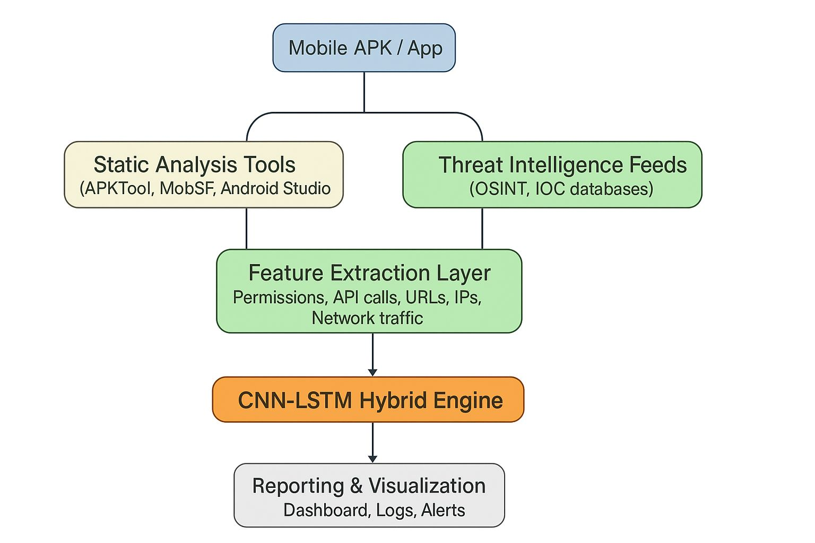
Architecture Diagram

Slide 12
Modules
1. Data Collection Module
Collect APKs from AndroZoo, CIC-AndMal2020.
2. Static Feature Extraction Module
Extract permissions, API calls, manifest details.
3. Dynamic Feature Extraction Module
Capture system calls, network traffic (DroidBox, Wireshark).
4. Preprocessing Module
Normalize and transform features into numerical vectors.
5. Hybrid Detection Module
Apply CNN for spatial/static feature learning.
Apply LSTM for sequential/dynamic feature learning.
6. Classification & Evaluation Module
Predict benign/malicious.
Evaluate with Accuracy, Precision, Recall, F1-score.

Slide 13
Hardware details
1. Processor: Intel i5/i7
2. RAM: Minimum 8 GB (recommended 16 GB for ML/DL training)
3. Storage: 250 GB SSD or higher
4. GPU : NVIDIA CUDA-enabled GPU for deep learning models

Slide 14
Software Requirements
1. Operating System: Windows 10/11 or Linux (Ubuntu preferred for ML/DL)
2. Programming Language: Python 3.8+
3. Libraries/Frameworks:
  Scikit-learn, TensorFlow / PyTorch, Pandas, NumPy, Matplotlib
4. Tools:
  Android Studio (for APK analysis)
  APKTool / MobSF (for static analysis)
  Wireshark / Frida (for dynamic analysis, if included)
  Jupyter Notebook / Google Colab for model development
5. Version Control: GitHub

Slide 15
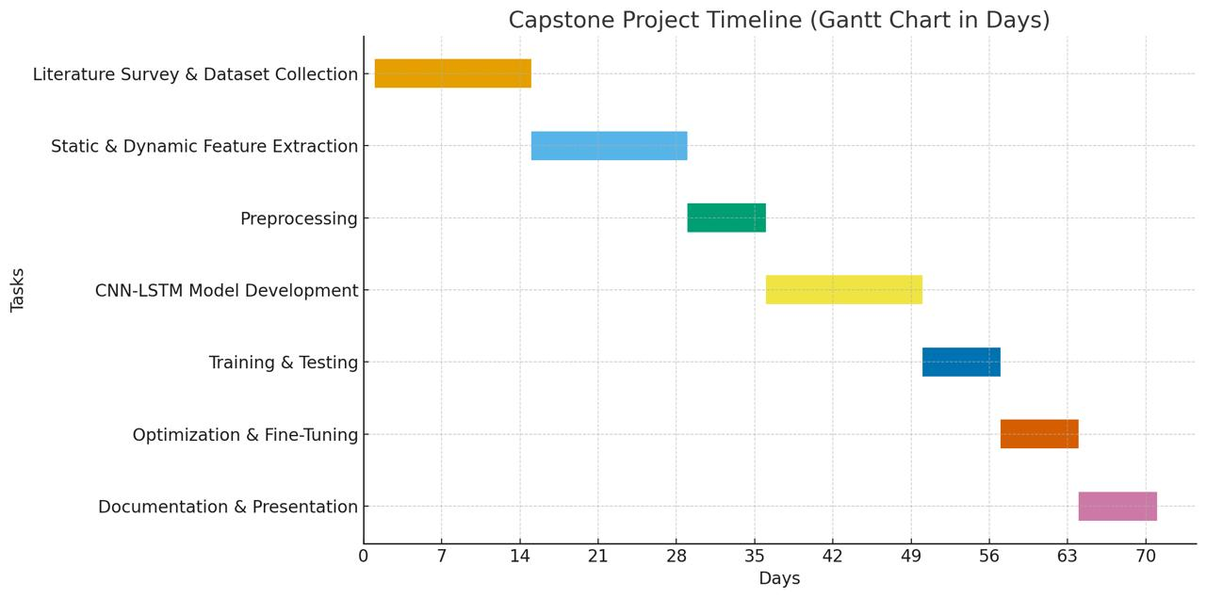
Timeline
Phase | Day | Activities
Dataset Collection & Literature Study | 1–2 | Collect APKs, review research papers
Static & Dynamic Feature Extraction | 3–4 | Use APKTool, DroidBox, Wireshark
Preprocessing | 5 | Feature engineering, normalization
Model Development | 6–7 | Implement CNN-LSTM hybrid model
Training & Testing | 8 | Evaluate using accuracy, precision, recall
Optimization & Fine-Tuning | 9 | Hyperparameter tuning, model improvements
Documentation & Review | 10 | Prepare report & presentation

Slide 16
References (IEEE Paper format)
[1] W. Enck et al., “TaintDroid: An Information-Flow Tracking System for Real-Time Privacy Monitoring on Smartphones,” OSDI, 2010.
[2] S. Arzt et al., “FlowDroid: Precise Context, Flow, Field, Object-sensitive and Lifecycle-aware Taint Analysis for Android Apps,” PLDI, 2014.
[3] D. Arp et al., “DREBIN: Effective and Explainable Detection of Android Malware in Your Pocket,” NDSS, 2014.
[4] E. Mariconti et al., “MaMaDroid: Detecting Android Malware by Building Markov Chains of Behavioral Models,” NDSS, 2017.
[5] K. Allix et al., “AndroZoo: Collecting Millions of Android Apps for the Research Community,” MSR, 2016.
[6] F. Wei et al., “Deep Ground Truth Analysis of Current Android Malware (AMD Dataset),” 2017.
[7] S. Rastogi et al., “DroidBox: Android Application Sandbox,” 2013; and extensions in CuckooDroid.
[8] Y. Hei et al., “HAWK: Android Malware Detection with Heterogeneous Graph Attention Networks,” 2021.
[9] X. Chen et al., “Android HIV: A Study of Repackaging Malware for Evading Machine-Learning Detection,” 2018.
[10] M. Sharafaldin et al., “CICAndMal2020: A Dataset for Android Malware Detection,” CIC Lab, 2020.

Slide 17


